Slide 1

AGRARYANS
FARM EQUIPMENT RENTAL SYSTEM
PROJECT SUBMITTED TO
WORKSBOT APPLICATION PRIVATE LIMITED
TEAM MEMBERS
Abhijith A
Adithyan C L
Munawar V P
Harini
Varshani

Slide 2

ABSTRACT
Here, we developed an E-commerce website to bridge the gap between vender and farmers. We are trying to provide services like taking required equipment from a vender on a rent basis. As information concerning farm-related equipment is not affordable to all farmer
The main objective of this website is to manage a fleet of agricultural machinery including various farming equipment such as harvester, JCB, Tractor, Pickup, rotor, and so on. This proposed system is user-friendly for end-user. The objective of the website is to deliver online farm-related equipment through the web platform. It helps to buy the equipment in the shop anywhere through the internet through Laptop and Computer
Users can enjoy the shopping from anywhere. It stores all information such as Customers record keeping, user just have to enter the primary information about a user and his/her account. Thus, our website is highly integrated. It also has an easy to use interface for farmer and vender

Slide 3

INTRODUCTION
In today’s world, every Farmer won’t have that much bank balance to buy each and every piece of farming equipment. The innovation is fast to the point that anybody can do anything by simply sitting in a room. So, it is an imperative issue as per observation. In the event that any farmer wishes to take equipment on rent and view equipment information, they can purchase online with the assistance of the web. If any new farmer wants to do farming, he doesn’t know about the farming equipment as per this concern this website is implemented. The system can access by any person no special training is needed to handle this. In this system, we are providing main two domains like vendor and farmer. These domains are managed by the administrator
Every farmer does not have sufficient money to buy every piece of equipment which is required for farming. So, here we are trying to provide service to farmer or user that they can take equipment on rent per hour basis. Comprehensive services that deliver equipment’s when and where needed, with minimum waste of resources. Our website has a facility to give a unique id for each and every farmer and also for vender and also registered equipment also.
All the information of vender, farmers, and also each and every piece of registered equipment is manually accessed by authorized admin. Because of this authorized access, the registered information is in the safe zone. Mainly security is provided to registered data no unauthorized person can access any other personal information. This system can also help to reduce the demand of labors which are required for efficient farming

Slide 4
PROBLEM STATEMENT
Every farmer does not have sufficient money to buy every equipment which will require for the farming. So, here we are trying to provide service to the farmer or user that farmers can buy equipment’s on per hour rent basis.
Comprehensive services that deliver equipment’s, when and where needed, with minimum waste of resources. Our software has the facility to give a unique id for every product and users. The details of every product and the user will store on database automatically

Slide 5
PROPOSTED SYSTEM
The Farm Equipment Rental System website is a user-friendly website. The main objectives of the system which shows and helps you to a farmer for buying equipment’s on rent basis, rent can be on hour basis. So, farmer or vender does not need to buy every equipment which they required. The design and implementation of the system are simple. The system needs very low system resources and the system will work in almost all configurations

Slide 6
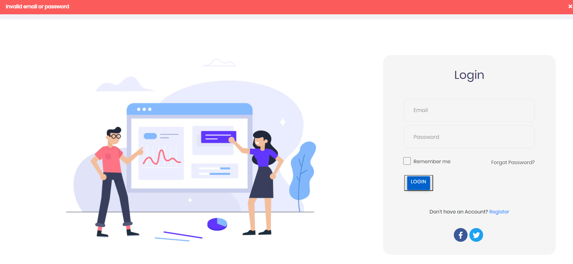

Slide 7
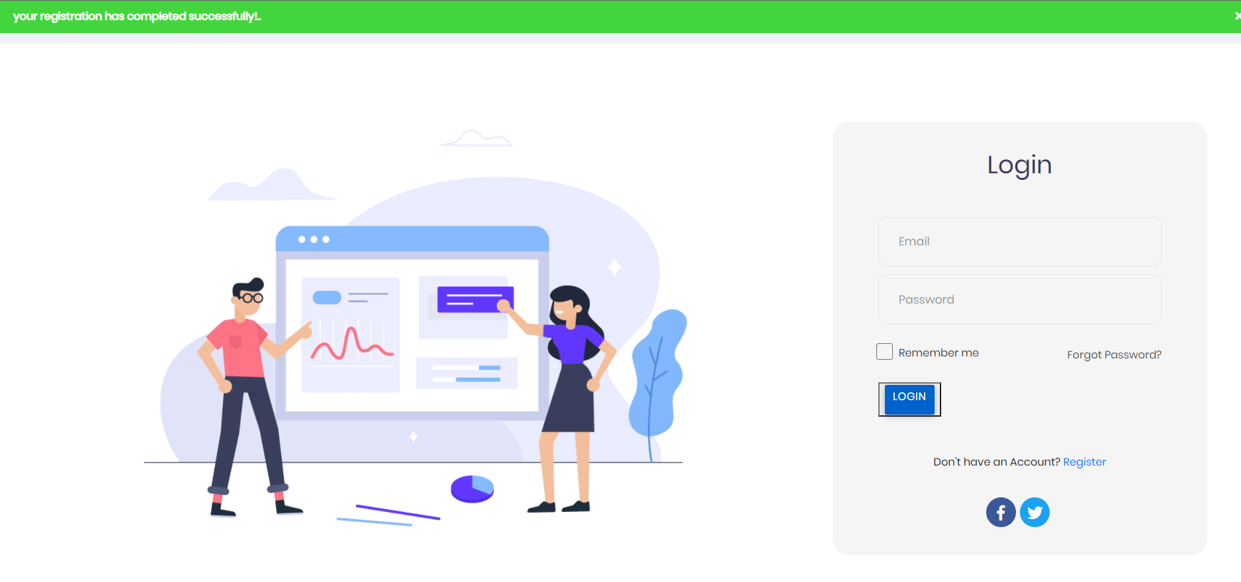

Slide 8
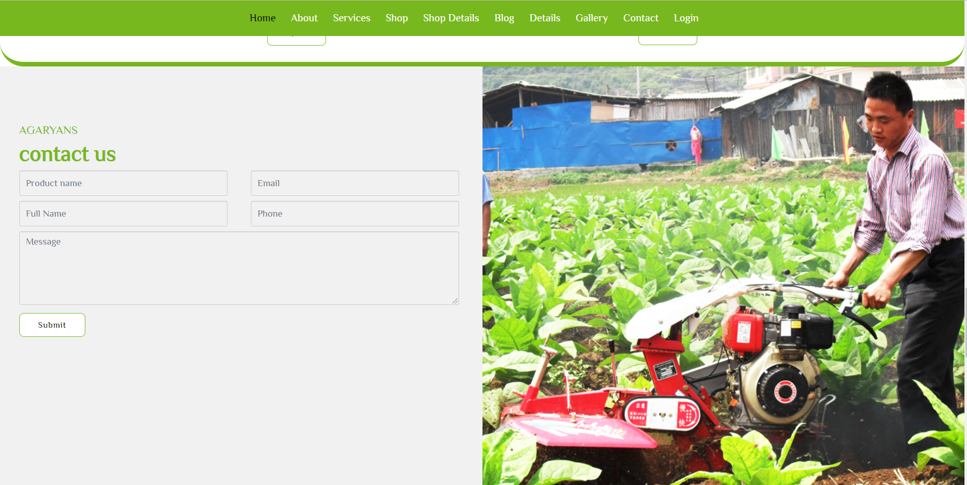
CONTACT FORM

Slide 9
DEVELOPMENT TOOLS
The entire development process has been subdivided into two: the front-end development and the backend development. The front end comprises of the visually visible parts such as the home page, admin panel, contact page, About us page, vender and farmer panel. The back end contains the database and its interaction with the front-end
SOFTWARE INTERFACES
BACK-END
FONT-END
HTML 5
CSS 3
Framework – BOOTSTRAP 5
JAVASCRIPT
Python 3
Framework- Django 3
Database- SQLlite 3

Slide 10
CONCLUSION
World Wide Web has become a major resource in modern business it gives new opportunities to business. The website is attractive, provides easy navigation, multiple options in terms of brands, category and capacity the farmer would stay on the site. This paper provides an easier design to implement the website and this system not only provides easy navigation but also it can increase the profitability and reduce time, efforts of farmer and make sure that all important information are able to use in future use. Hence the proposed system has following features.
Multiple add to carts can be provided per user.
A desktop-based application for the website can be developed.
Payment through Paytm could be made possible.
Send SMS to the users on registered mobile N0

Slide 11
References
S. Y. Jung. Study on the web-based maintenance and management system of smallscale public research facilities. Chonnam National University, Department of Architectural Engineering;2011. MS thesis
Seung-Yeoub Shin, Chang-Ho Kang. 2014. ‘Web-based Agricultural Machinery Rental Business Management System’. National Academy of Agricultural Science Korea Department of Bio-Mechatronic Engineering, Sungkyunkwan University, Suwon, Korea
References from YouTube
References from Wikipedia

